Slide 1

RESPONSIVE WEB DESIGN

Slide 2
Introduction
• Theꢀnumberꢀofꢀhandheldꢀdevicesꢀoperatingꢀworldwideꢀisꢀ
growingꢀexponentially.ꢀAccordingꢀtoꢀstats,ꢀmoreꢀthanꢀ90%ꢀofꢀ
adultsꢀownꢀaꢀcellꢀphone,ꢀwhereasꢀalmostꢀ50%ꢀofꢀsmartphoneꢀ
usersꢀadmitꢀthatꢀtheyꢀcouldꢀnotꢀliveꢀwithoutꢀtheirꢀdevices.ꢀWhatꢀ
canꢀweꢀsay;ꢀtheꢀmobileꢀwebꢀisꢀaꢀhugeꢀthingꢀtheseꢀdays.ꢀThatꢀ
whyꢀinꢀthisꢀpostꢀweꢀwriteꢀaboutꢀresponsiveꢀwebꢀdesignꢀandꢀ
showꢀsomeꢀgoodꢀexamplesꢀfromꢀtheꢀindustry.

Slide 3

WhatꢀisꢀResponsiveꢀWebꢀDesign?
• ꢀResponsiveꢀwebꢀdesignꢀisꢀanꢀapproachꢀthatꢀensuresꢀallꢀtheꢀ
pagesꢀofꢀtheꢀwebsiteꢀlook,ꢀworkꢀandꢀfeelꢀperfectlyꢀonꢀanyꢀ
device.ꢀWhetherꢀitꢀisꢀaꢀtinyꢀoldꢀcellꢀphoneꢀwithꢀaꢀscreenꢀwidthꢀofꢀ
320px,ꢀaꢀmodernꢀphabletꢀwithꢀ7ꢀinchesꢀscreen,ꢀaꢀbigꢀiPad,ꢀorꢀaꢀ
TVꢀwithꢀaꢀmassiveꢀdiagonalꢀline,ꢀallꢀtheꢀmainꢀaspectsꢀsuchꢀasꢀ
content,ꢀdesign,ꢀandꢀespeciallyꢀfunctionalityꢀshouldꢀperformꢀ
consistentlyꢀtoꢀprovideꢀusersꢀwithꢀanꢀexcellentꢀuserꢀexperience.
• Inꢀtechnicalꢀterms,ꢀresponsiveꢀwebꢀdesignꢀimpliesꢀaꢀsetꢀofꢀ
instructionsꢀthatꢀhelpꢀwebꢀpagesꢀchangeꢀtheirꢀlayoutꢀandꢀ
appearanceꢀtoꢀmeetꢀdifferentꢀscreenꢀwidthsꢀandꢀresolutions.

Slide 4
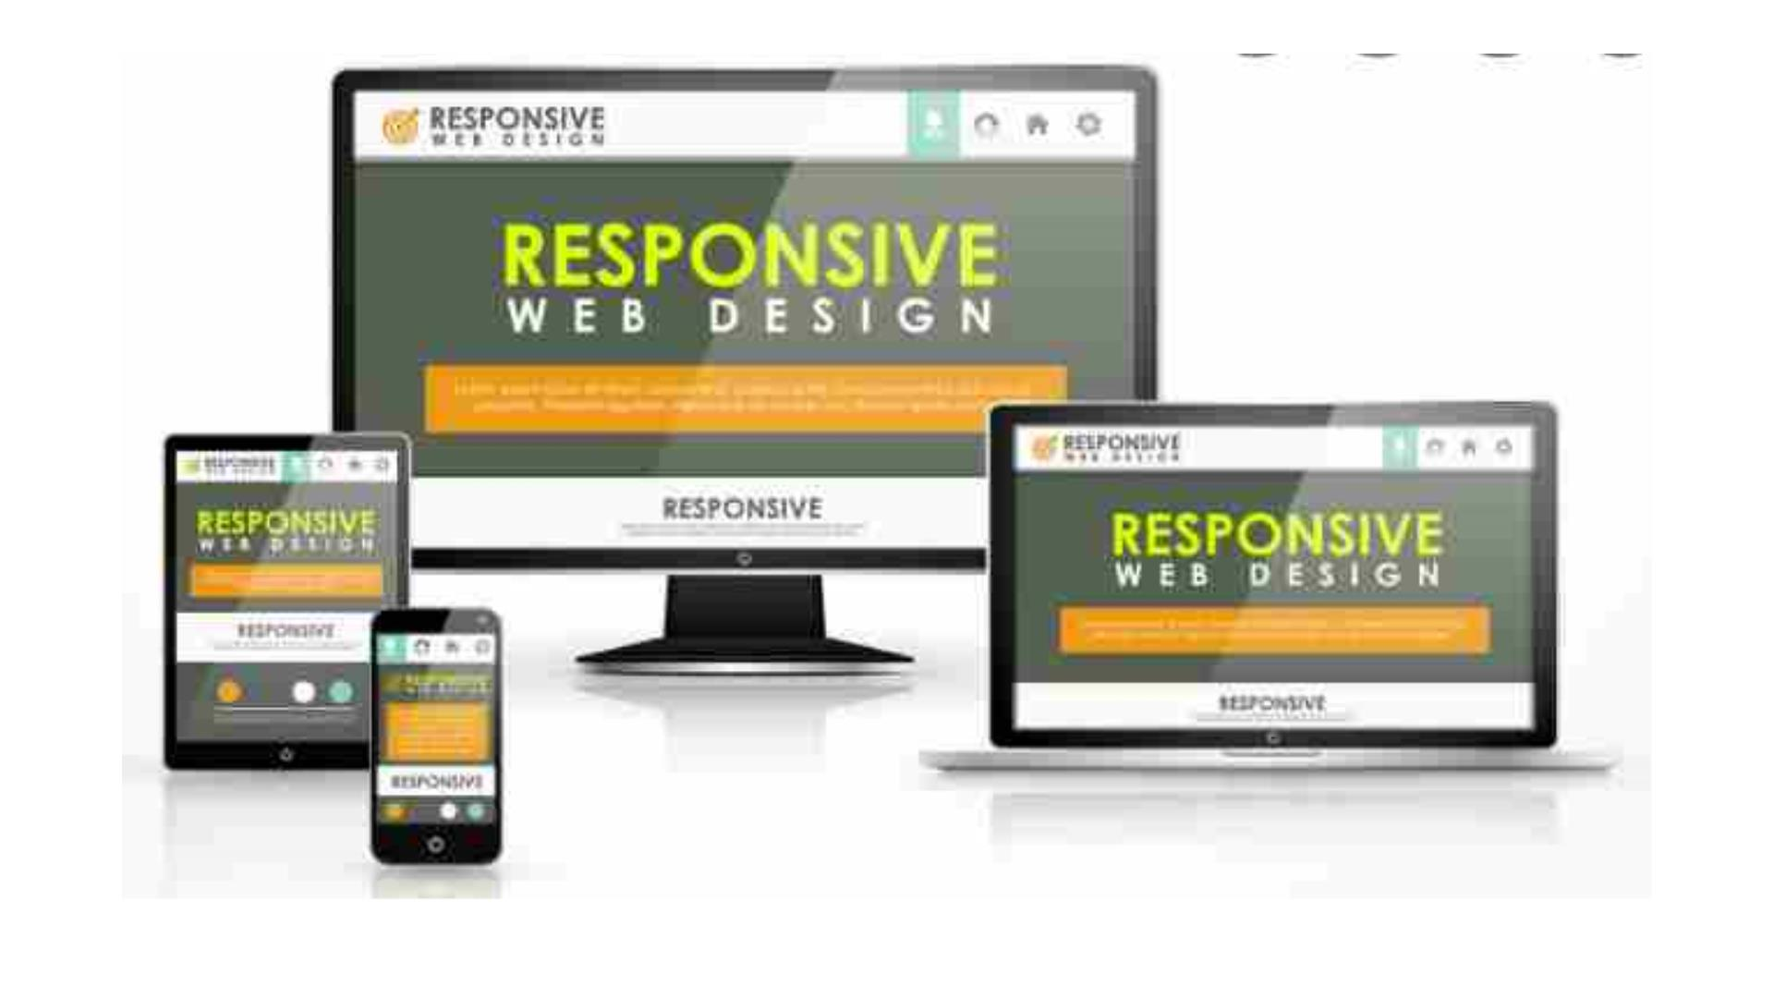

Slide 5
BenefitsꢀofꢀResponsiveꢀWebꢀDesign
• Theꢀmainꢀbenefitsꢀofꢀusingꢀaꢀresponsiveꢀwebsiteꢀare
• consistentꢀvisualꢀexperience;
• betterꢀuserꢀexperience;
• noꢀneedꢀforꢀredirects;
• lowerꢀbounceꢀrates;
• lowerꢀmaintenanceꢀneeds;
• highꢀwebꢀpageꢀloadingꢀspeed;
• noꢀextraꢀfeesꢀforꢀcreatingꢀandꢀmaintainingꢀdifferentꢀversions;
• easyꢀanalyticsꢀreporting.

Slide 6
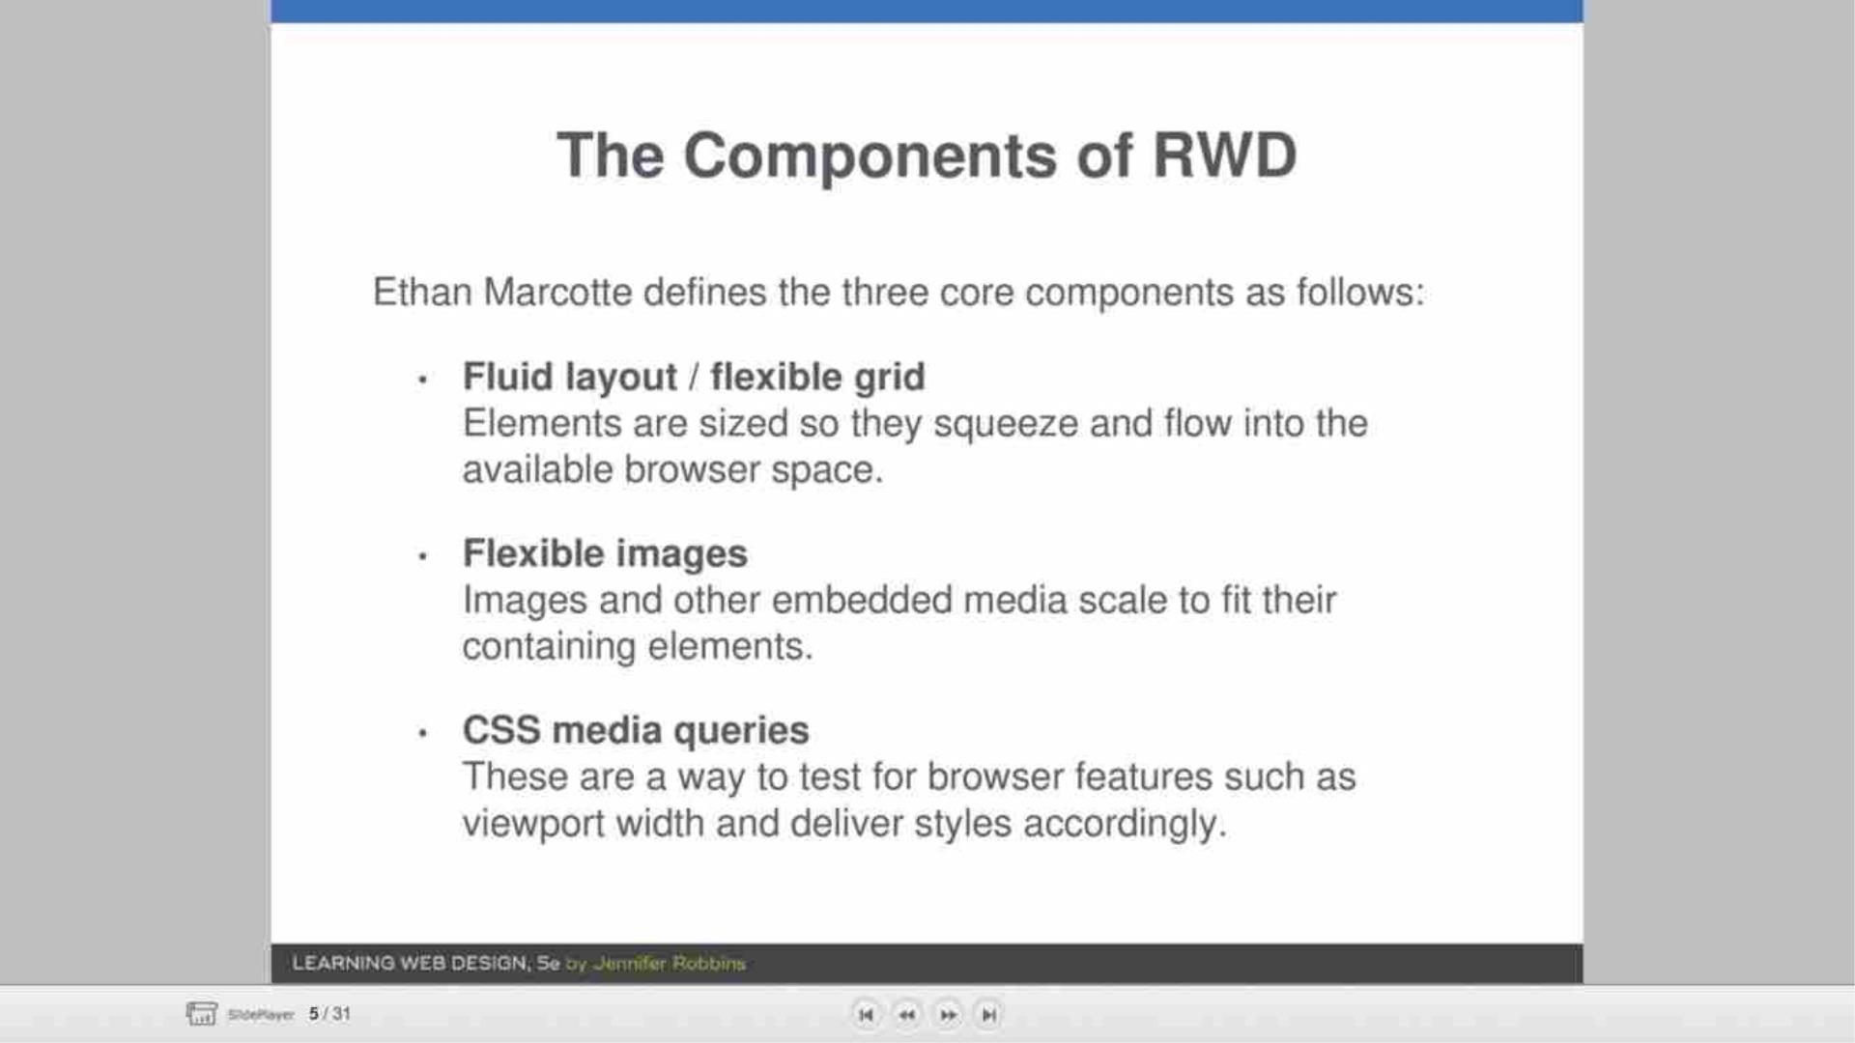

Slide 7
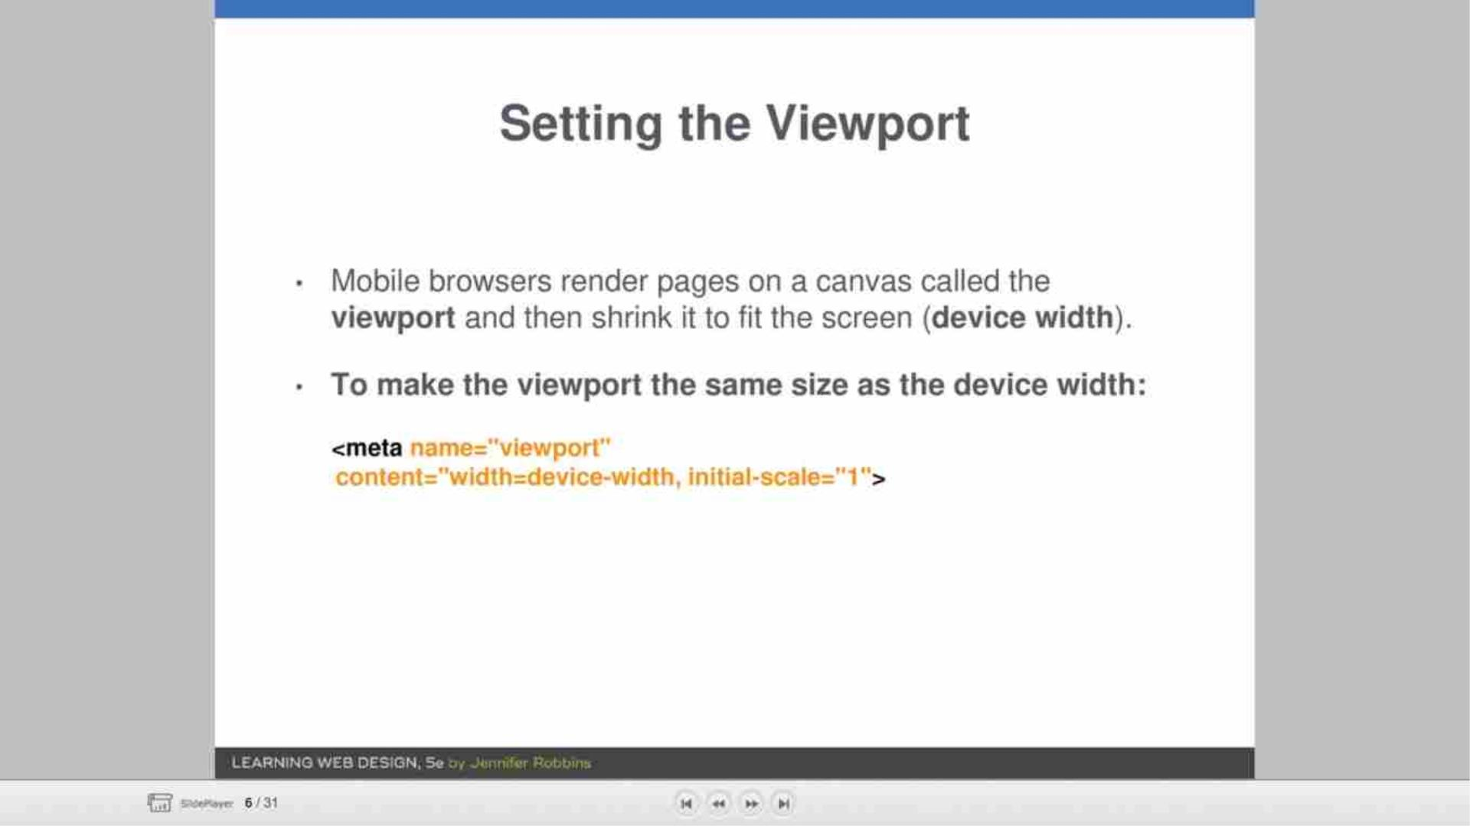

Slide 8
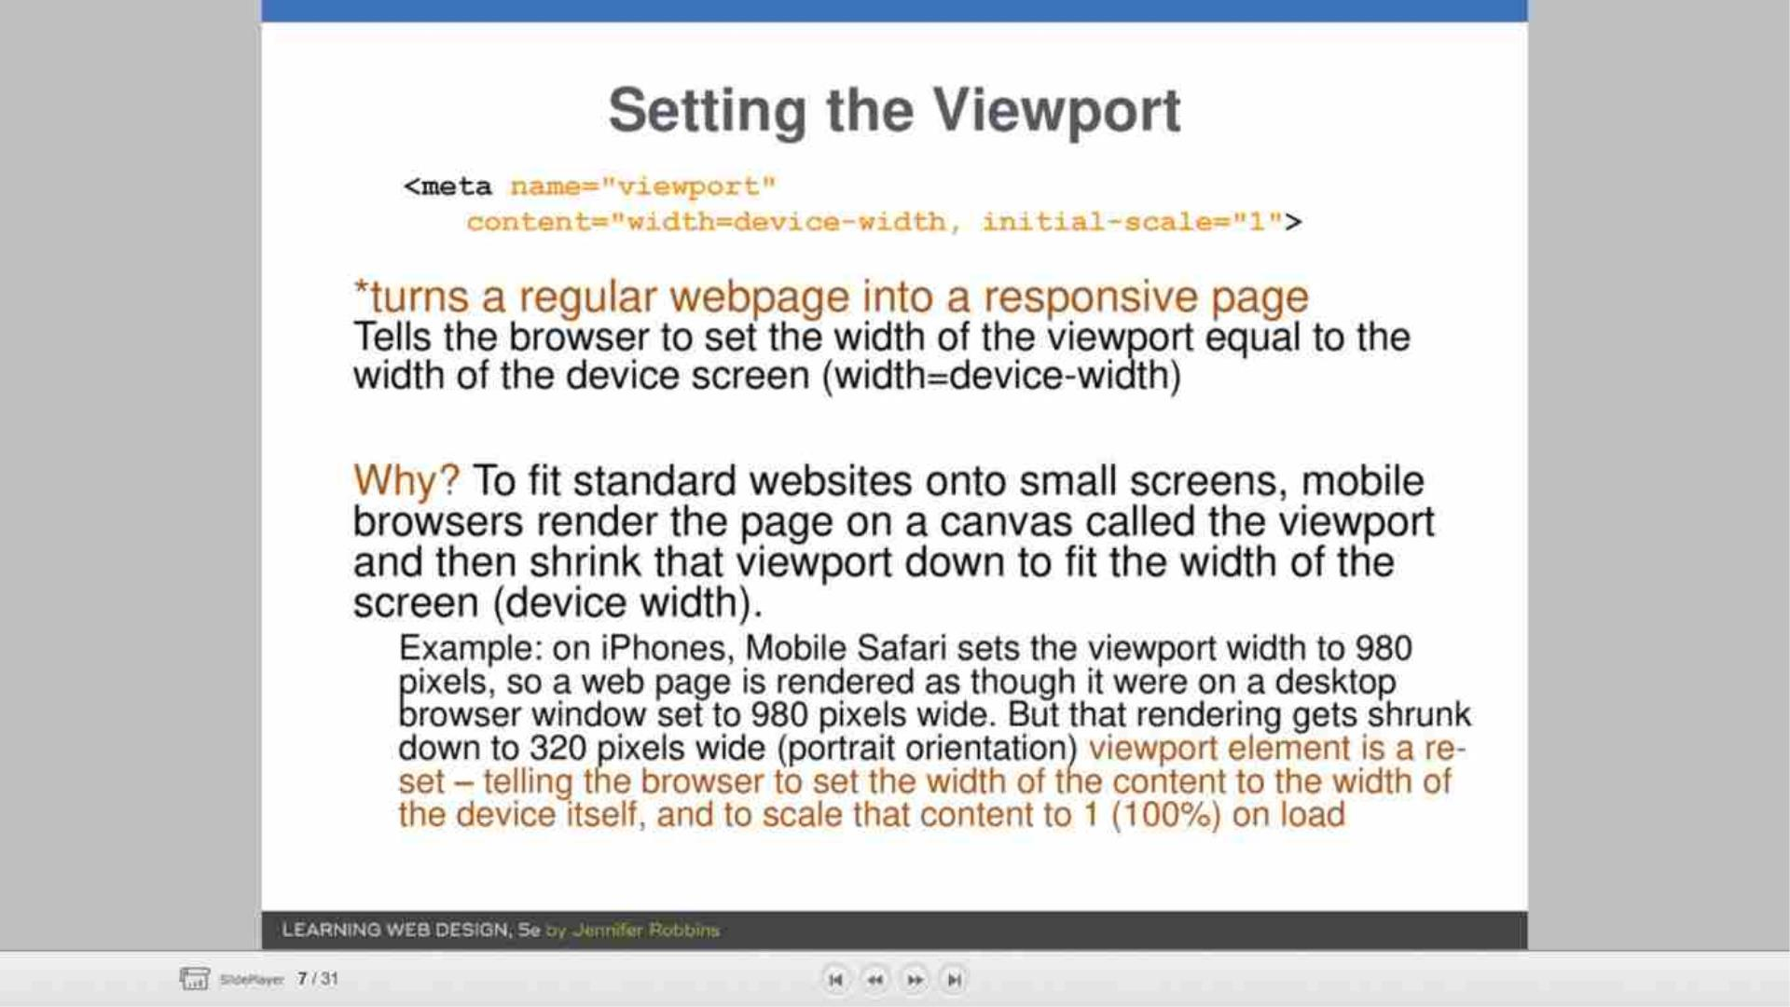

Slide 9
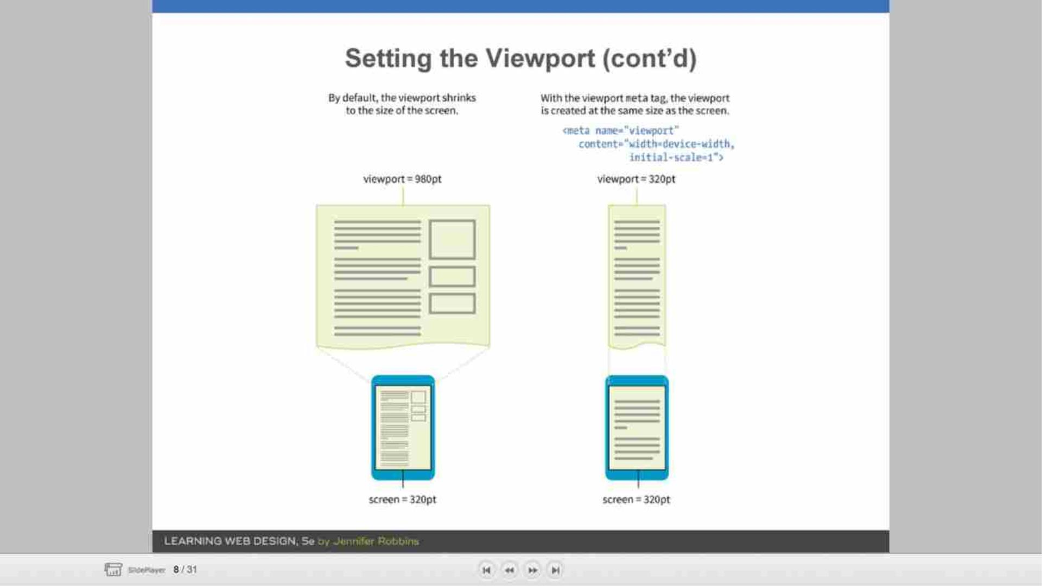

Slide 10
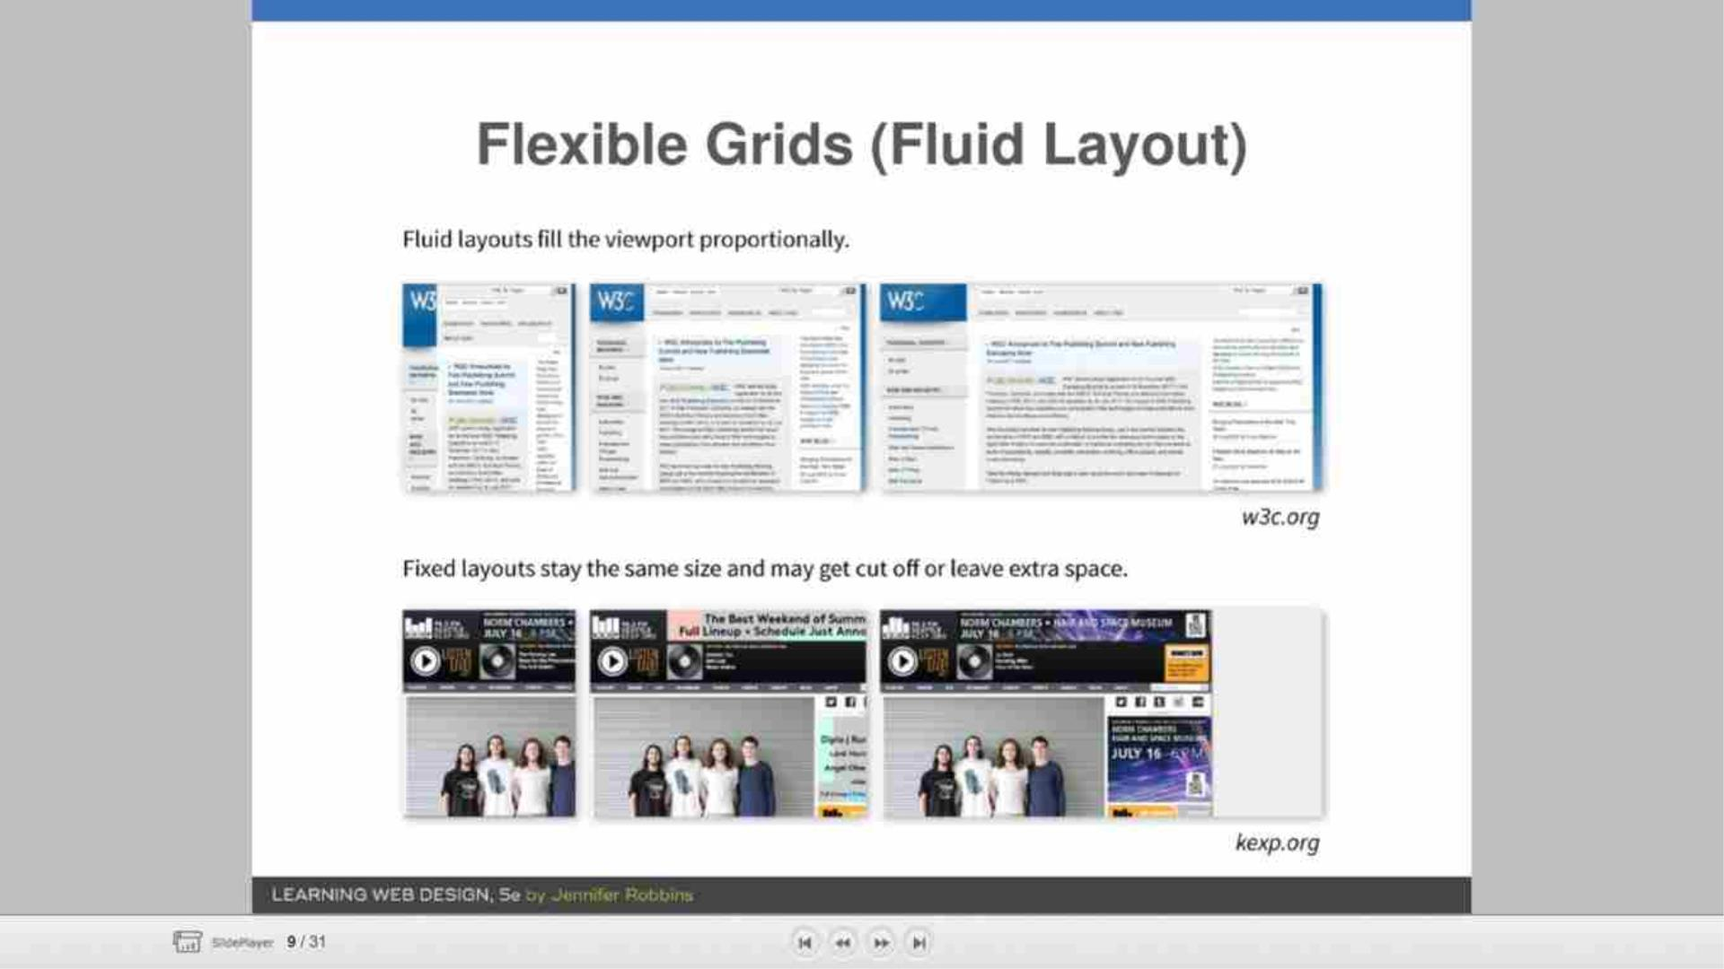

Slide 11
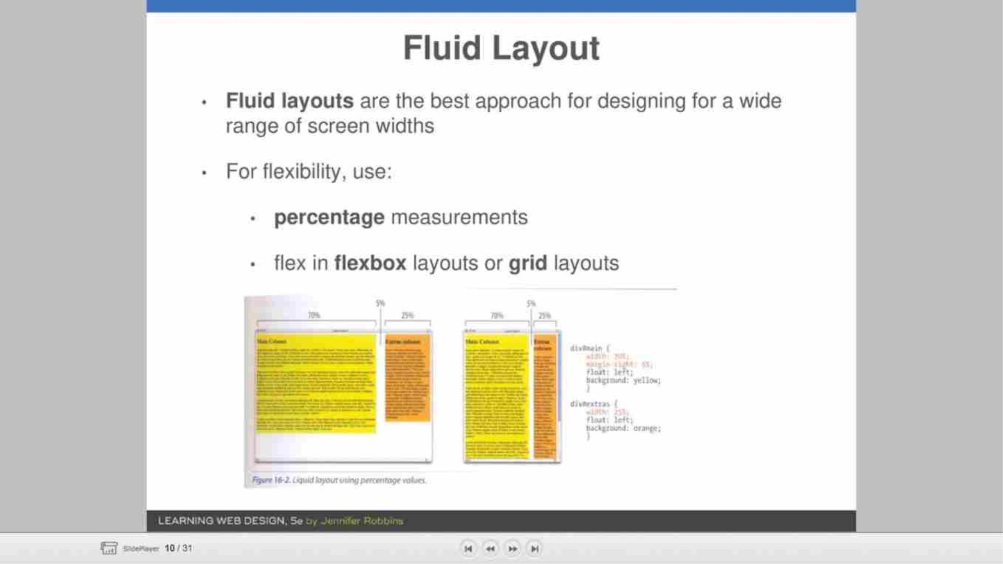

Slide 12
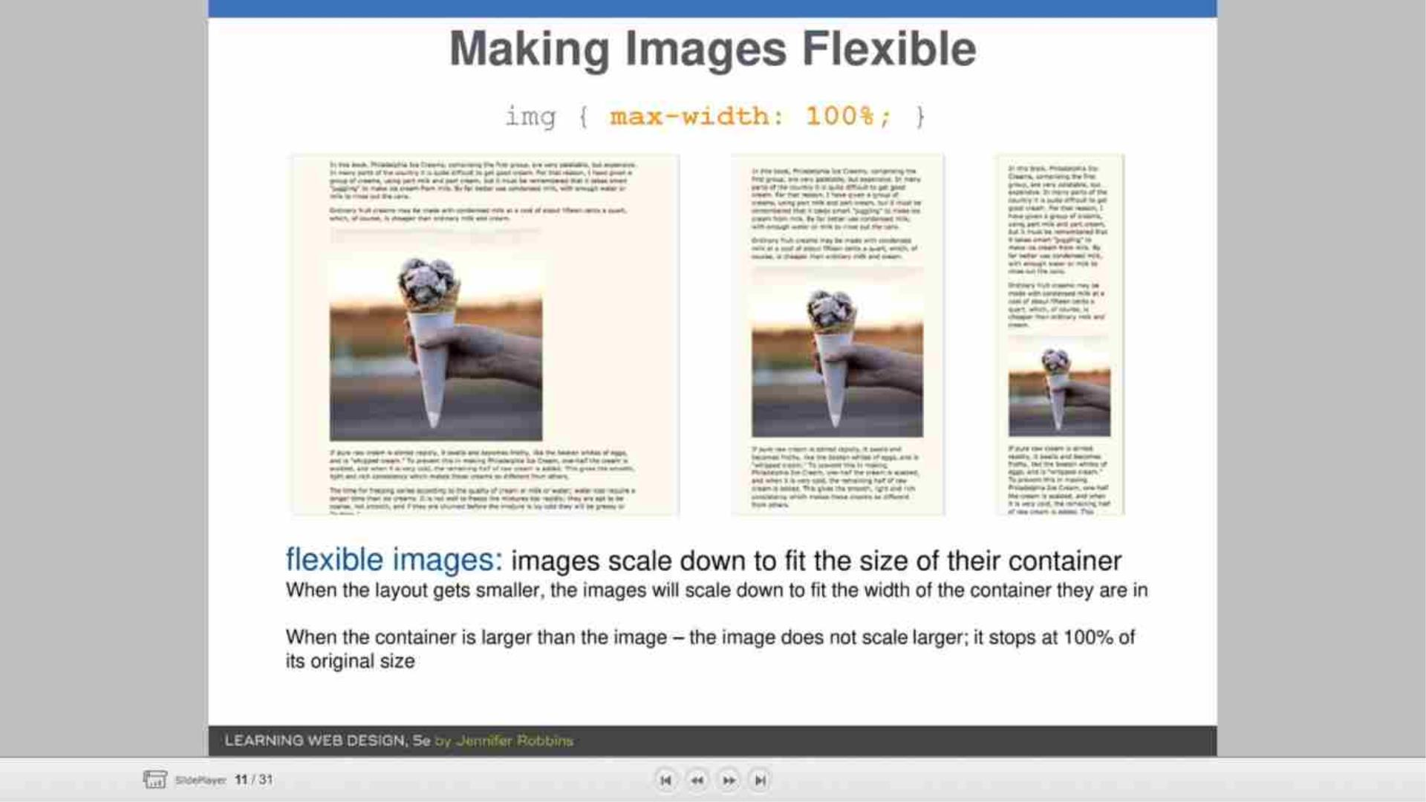

Slide 13
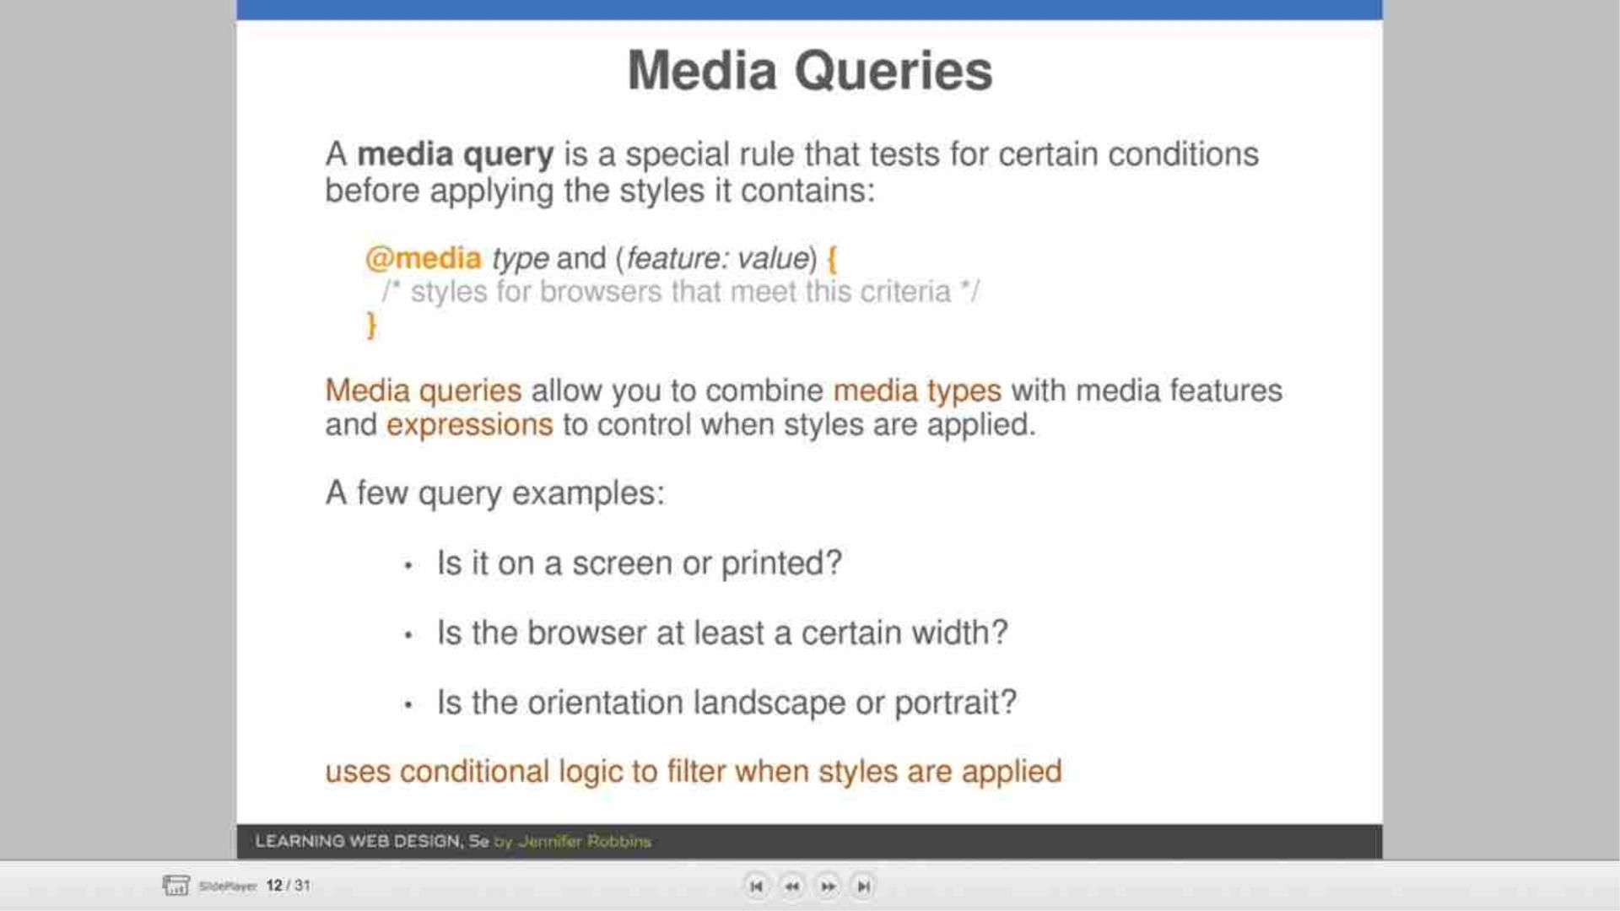

Slide 14
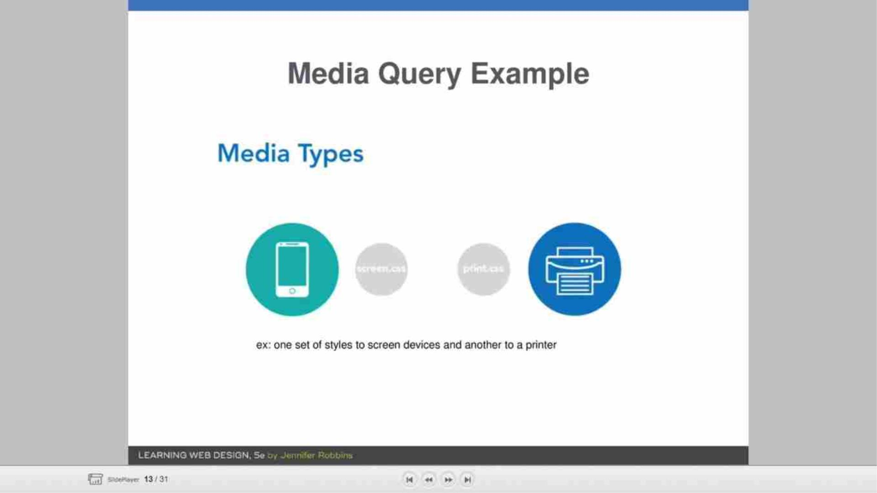

Slide 15
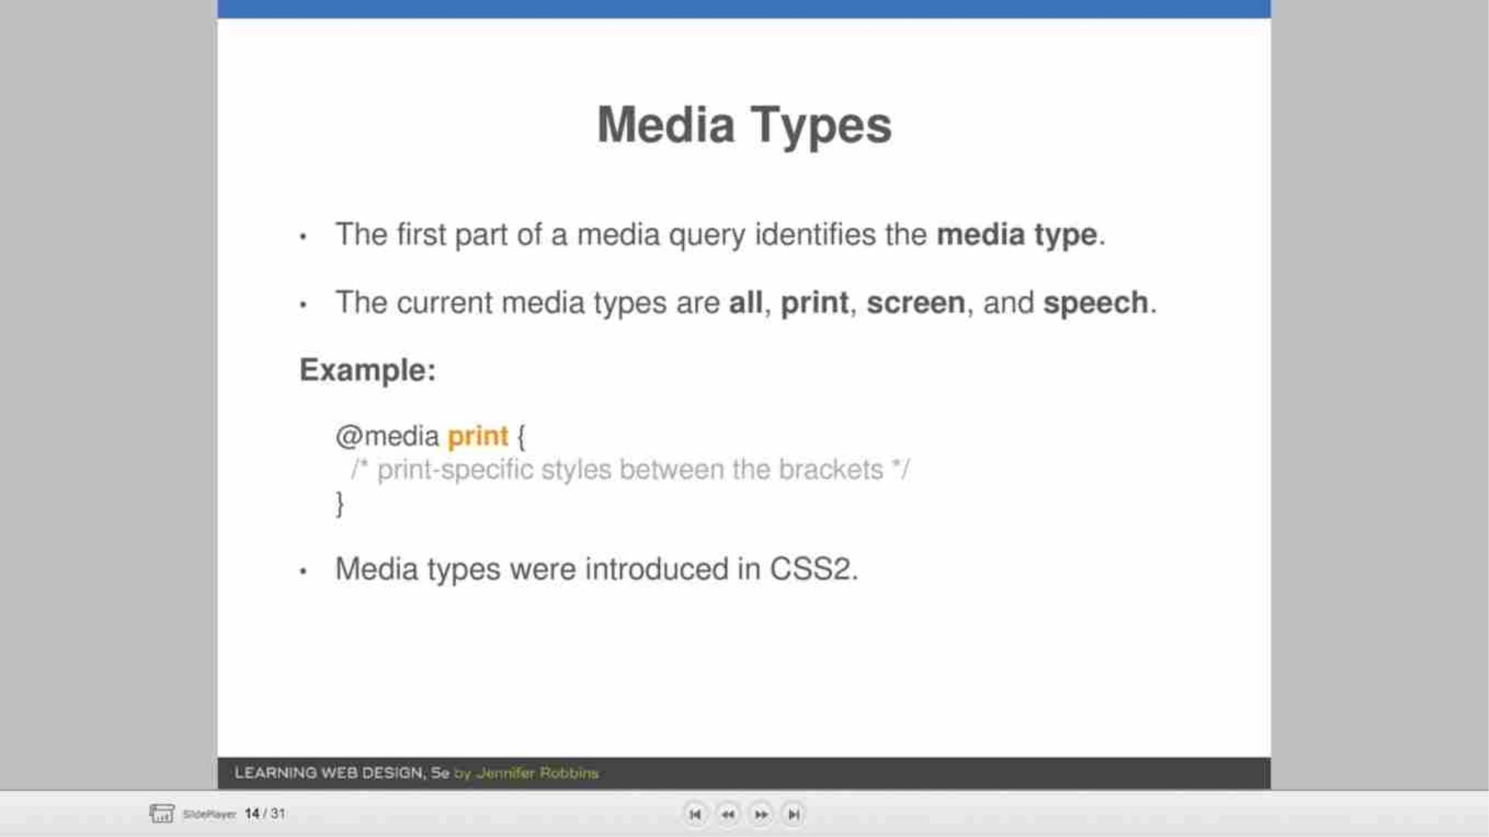

Slide 16
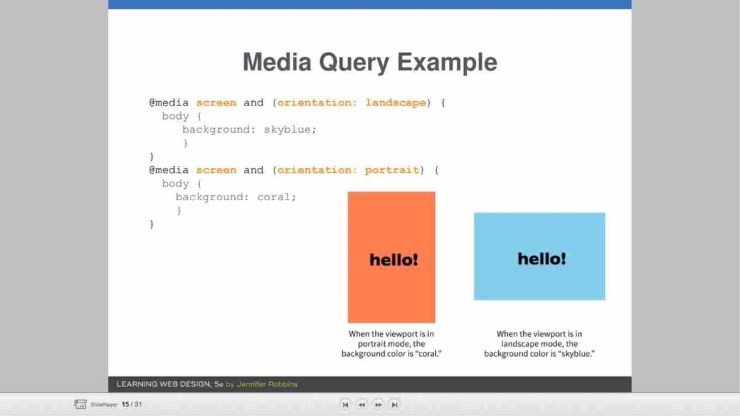

Slide 17
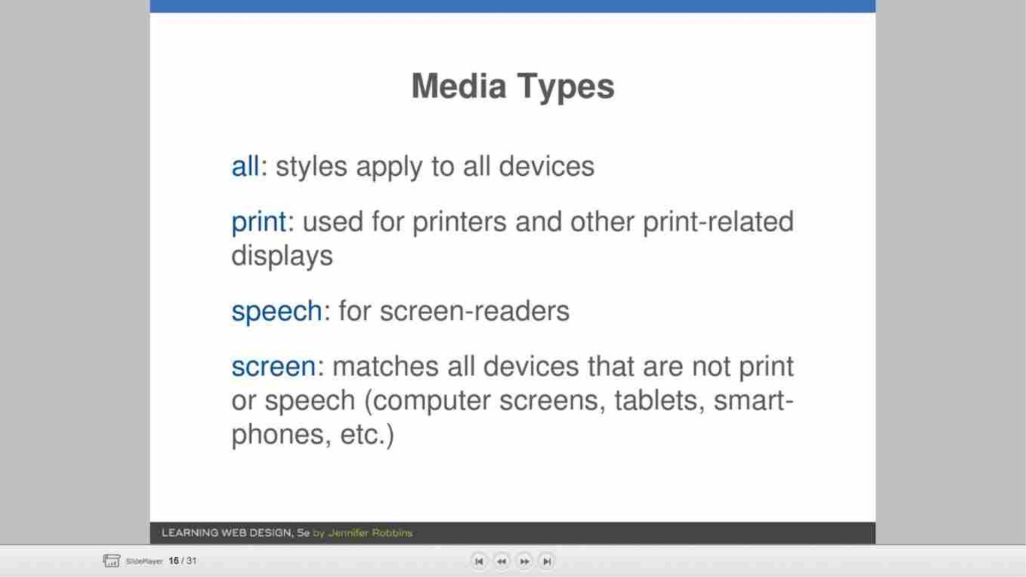

Slide 18
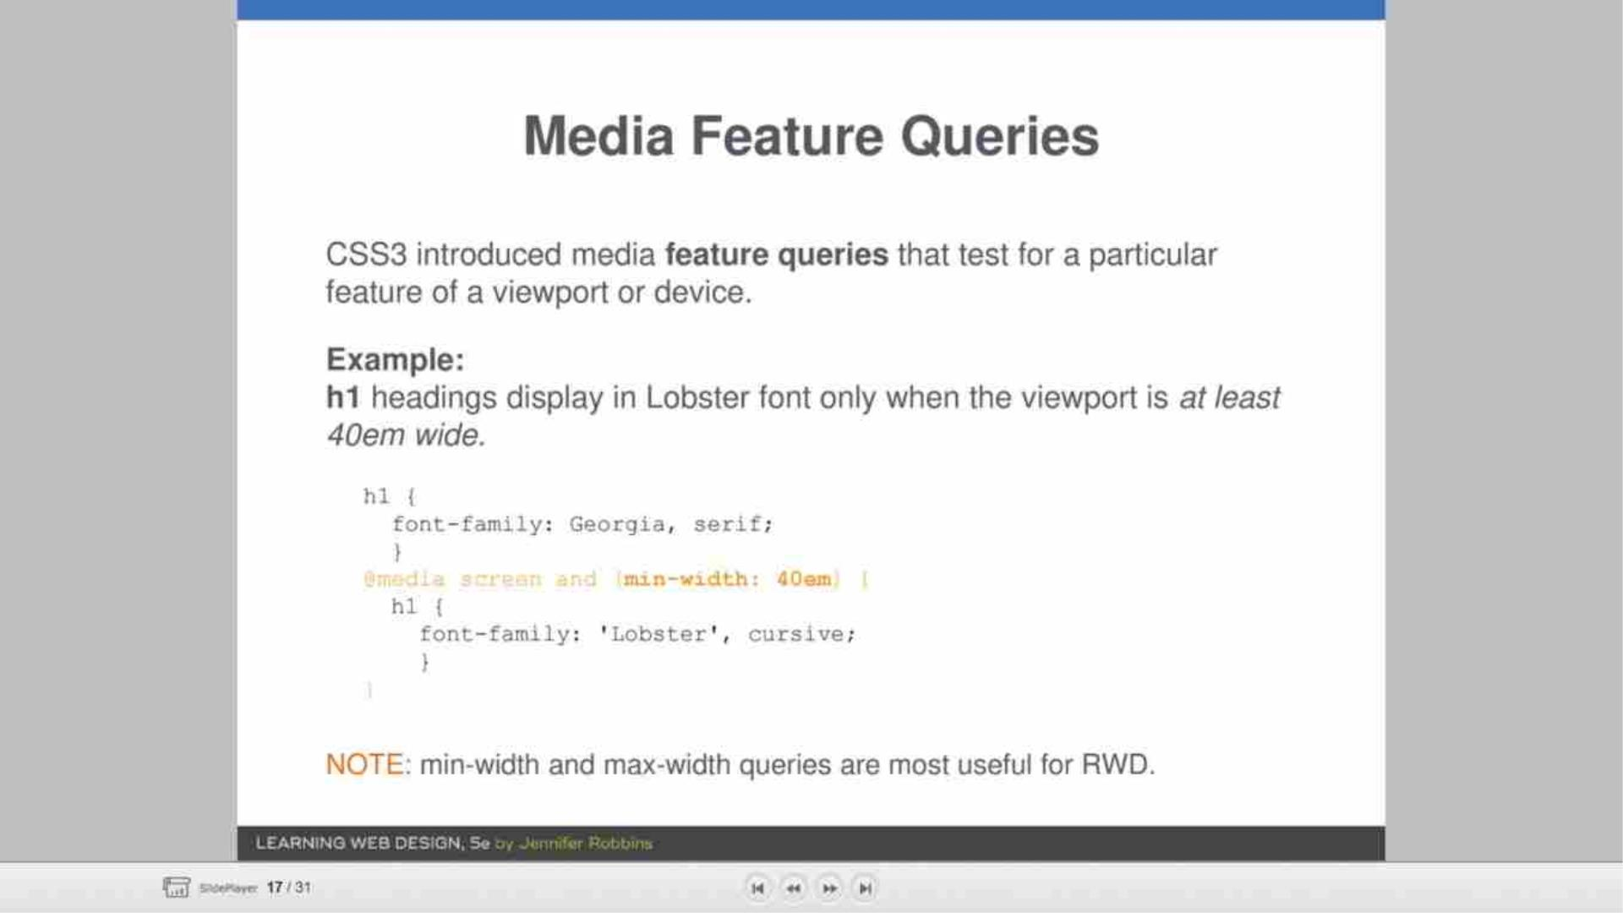

Slide 19
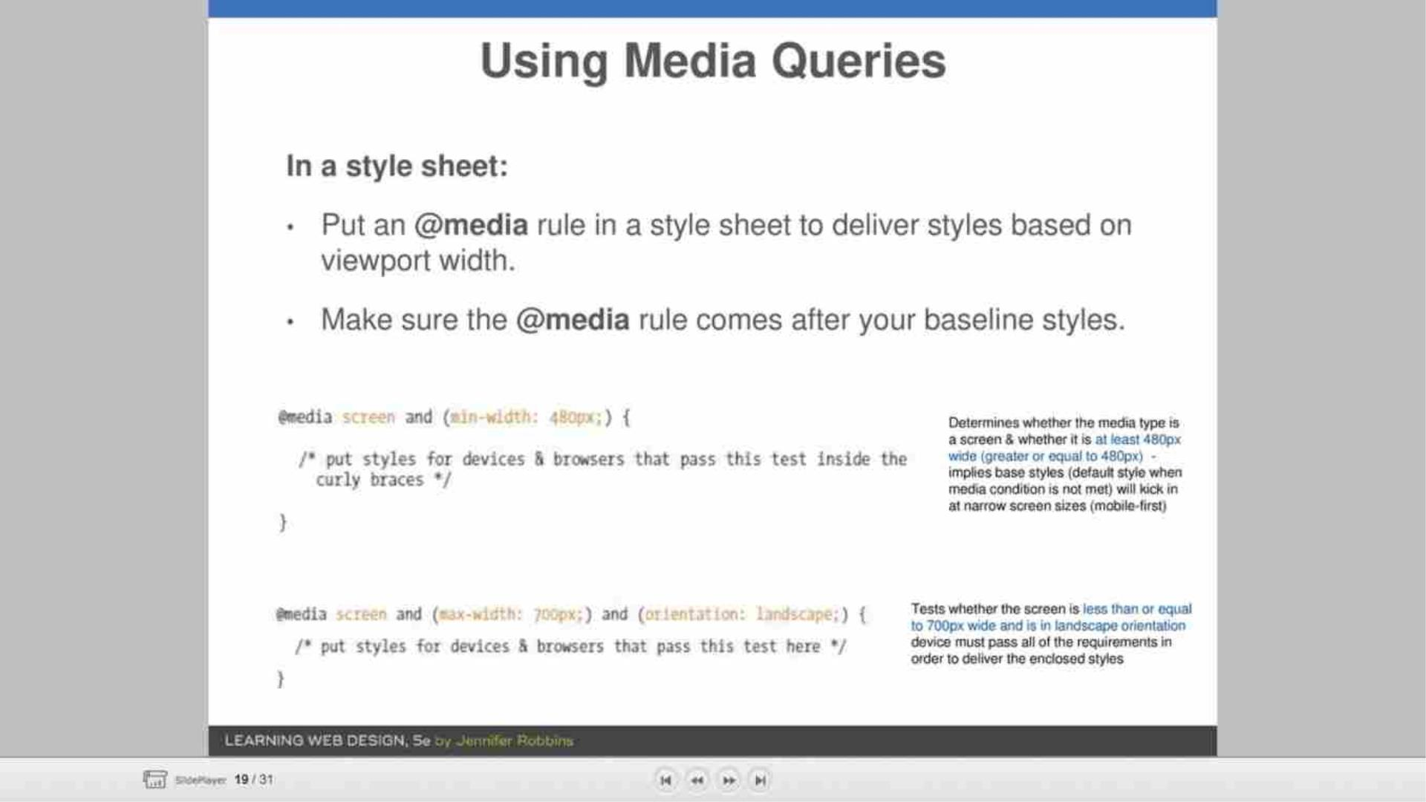

Slide 20
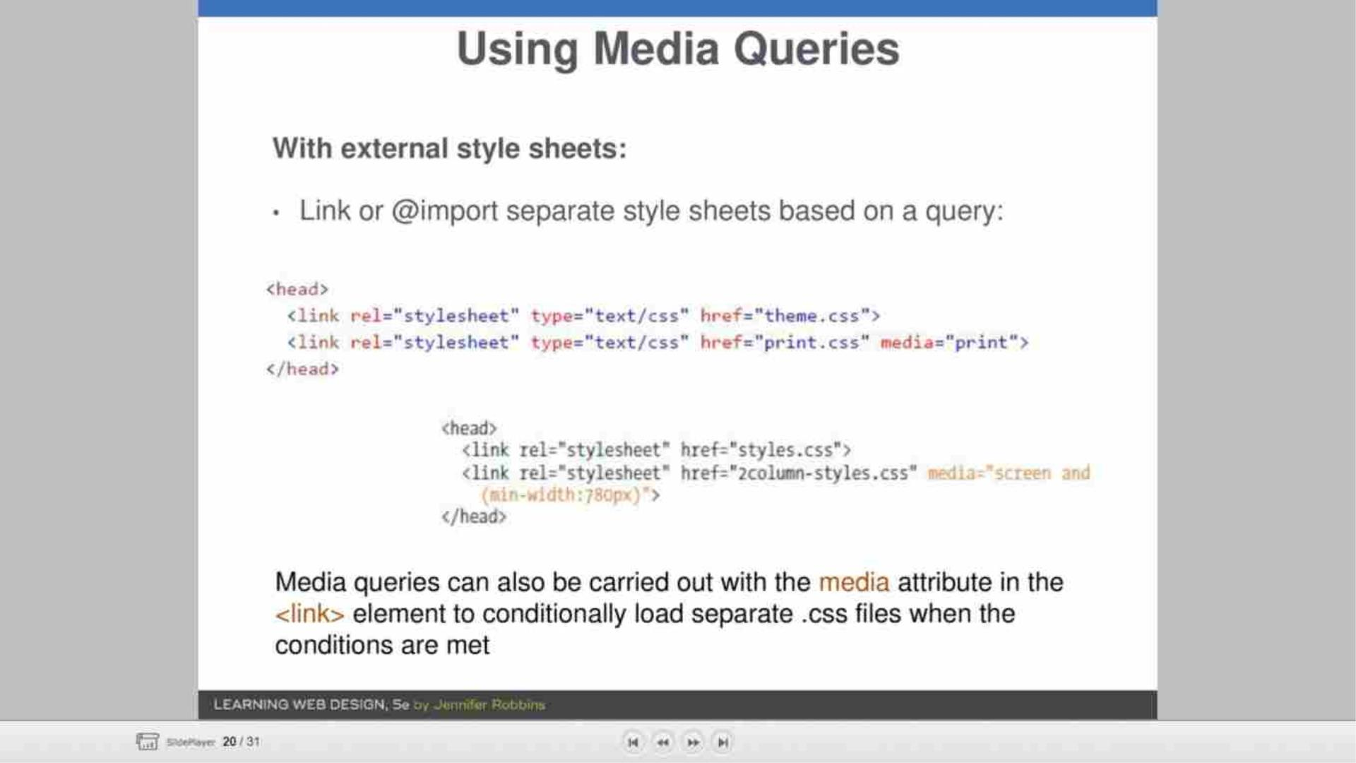

Slide 21
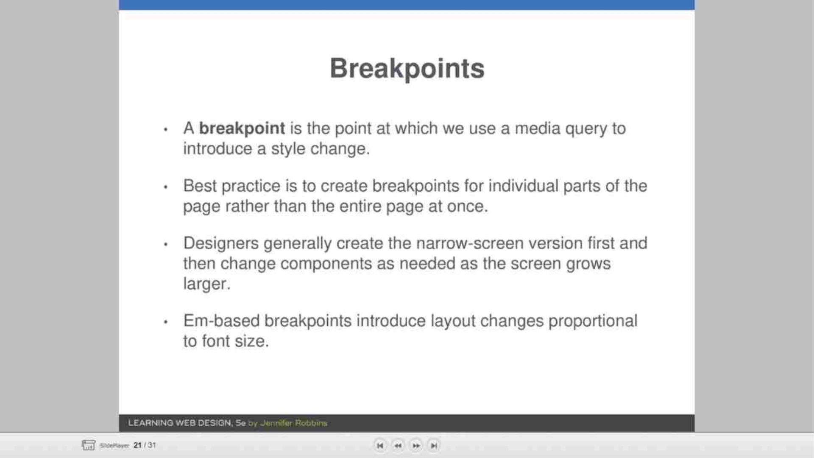

Slide 22
